Slide 1
Transitioning to Agile: Lessons from the SNHU Travel Project
An Overview of Scrum-Agile Implementation and Comparison with Waterfall
By Quinton Price

Slide 2
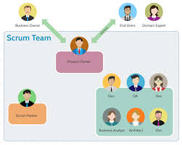
Explaining Agile Roles
Scrum Master: Facilitates Scrum events, removes impediments, ensures adherence to Scrum practices.
Product Owner: Defines product requirements, prioritizes backlog, makes decisions about features
Development Team: Executes development tasks, collaborates on design and implementation.

Slide 3
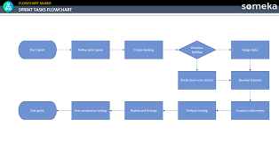
Explaining Agile Phases
Sprint Planning: Defines what to complete in the upcoming sprint.
Daily Standups: Short meetings to discuss progress and obstacles.
Sprint Review: Demonstrates completed work and gathers feedback.
Sprint Retrospective: Reflects on the sprint to improve processes.

Slide 4
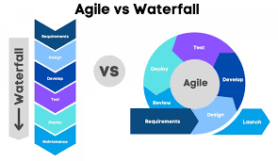
Describing Waterfall Model

Slide 5
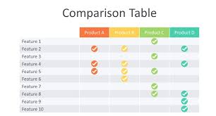
Describing Waterfall Model.
Linear Process: Sequential phases including Requirements, Design, Implementation, Testing, Deployment, and Maintenance.
Comparison: Waterfall is less flexible, with changes being more costly and disruptive compared to Agile's iterative approach.

Slide 6
Waterfall or Agile Approach
Factors to Consider: Project complexity, client needs, flexibility requirements, team experience.
Recommendation: Discuss when each approach might be preferable based on your project experience.

Slide 7
References
Scrum Alliance. (2023). The Scrum Guide. Retrieved from https://scrumguides.orgThis guide provides a comprehensive overview of Scrum roles, events, and artifacts, and is authored by Scrum creators Ken Schwaber and Jeff Sutherland.Schwaber, K., & Sutherland, J. (2020). The Scrum Guide. Scrum Alliance. Retrieved from https://scrumguides.orgThis is the definitive guide to Scrum, explaining its principles, practices, and roles.
Highsmith, J. (2022). Adaptive Software Development: A Collaborative Approach to Managing Complex Systems. Dorset House Publishing.This book provides insights into Agile methodologies and how they adapt to changes, which is essential for understanding Agile principles.

